Slide 1
Space Transformation Pipeline (3D)
CSU0021: Computer Graphics

Slide 2
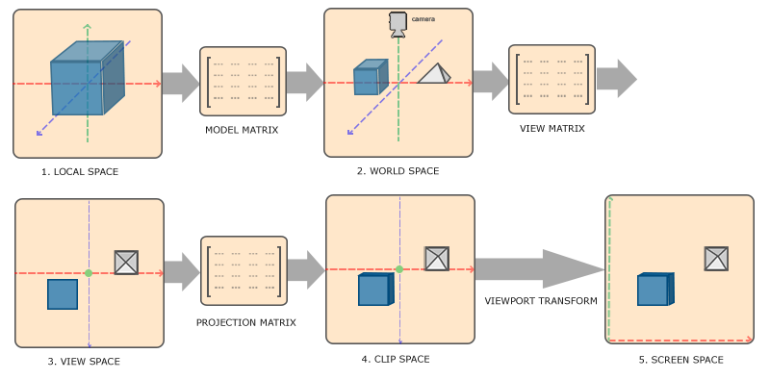
Coordinate System (Space)
We will talk about all these matrices/transformations one by one
This space transformation pipeline exactly tells you where to show a 3D point in the 2D screen space
What we learn in the past two weeks is this one (object space to world space)
What “gl_Position” in shader wants
is the coordinate in clip space
(Object/Model space)
we assume our viewport is the same as the
screen space in the past four weeks
https://learnopengl.com/Getting-started/Coordinate-Systems
http://www.codinglabs.net/article_world_view_projection_matrix.aspx

Slide 3
Model Matrix (Model to World Space)
(Object space)
https://learnopengl.com/Getting-started/Coordinate-Systems
http://www.codinglabs.net/article_world_view_projection_matrix.aspx

Slide 4
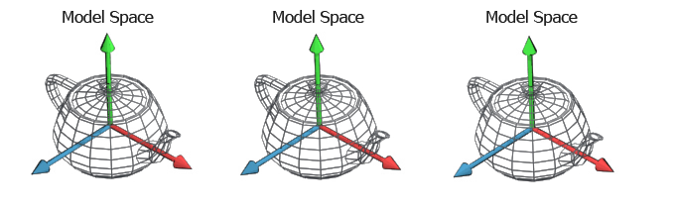
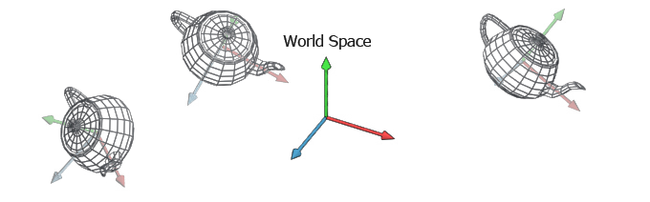
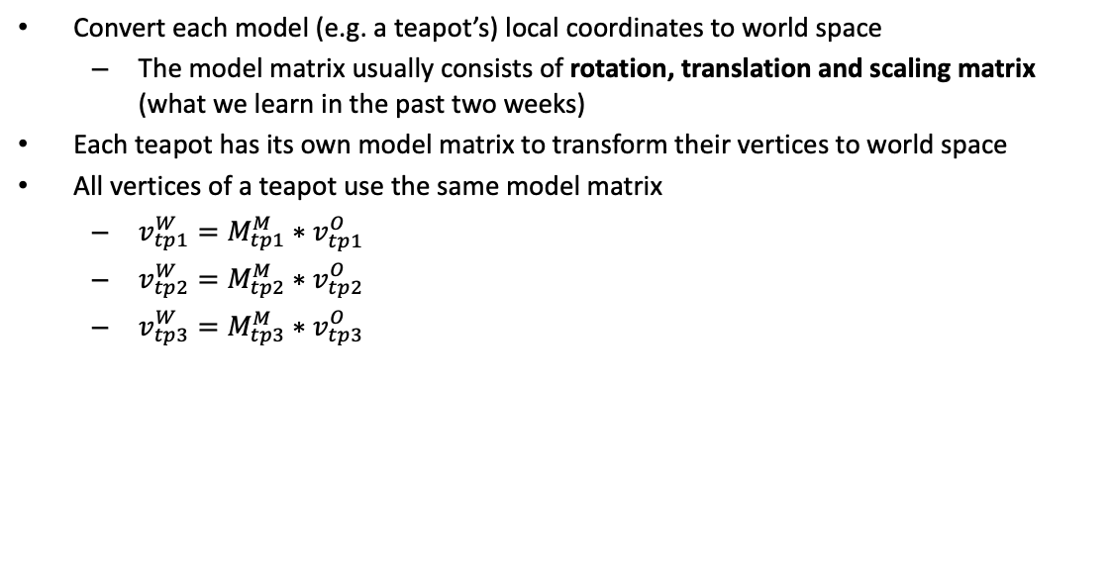
Model Matrix (Model to World Space)
Convert each model (e.g. a teapot’s) local coordinates to world space
The model matrix usually consists of rotation, translation and scaling matrix (what we learn in the past two weeks)
Each teapot has its own model matrix to transform their vertices to world space
All vertices of a teapot use the same model matrix
$v_{tp1}^{W}=M_{tp1}^{M}∗v_{tp1}^{O}$
$v_{tp2}^{W}=M_{tp2}^{M}∗v_{tp2}^{O}$
$v_{tp3}^{W}=M_{tp3}^{M}∗v_{tp3}^{O}$
object space
object space
object space
A vertex of teapot3 in object space
A vertex of teapot3 in world space
Teapot3’s model matrix

Slide 5

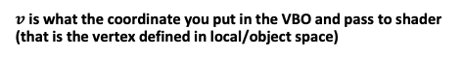
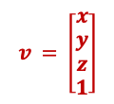
Coordinate System (Space)
$v$ is what the coordinate you put in the VBO and pass to shader
(that is the vertex defined in local/object space)
$$modelMatrix∗v$$
$$v = \left[\begin{matrix}x \\ y \\ z \\ 1\end{matrix}\right]$$
What “gl_Position” in shader wants
is the coordinate in clip space
(Object space)
https://learnopengl.com/Getting-started/Coordinate-Systems
http://www.codinglabs.net/article_world_view_projection_matrix.aspx

Slide 6
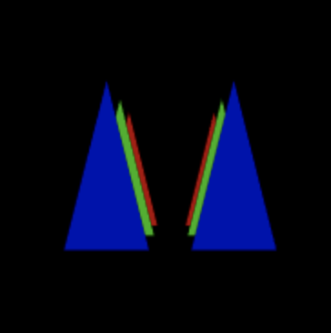

Example (Ex05-1)
In the end of today, we will draw six triangles
In Ex05-1, we only have the model matrix and we can only see a portion of two triangles
Files:
Index.html
WebGL.js
Cuon-matrix.js

Slide 7
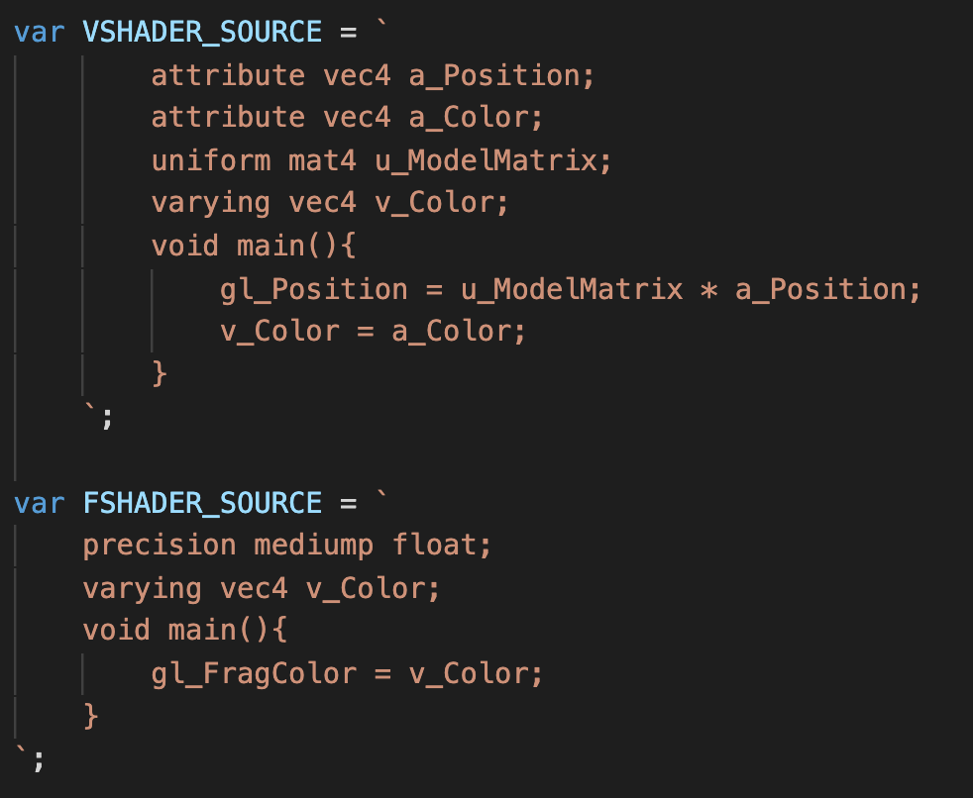
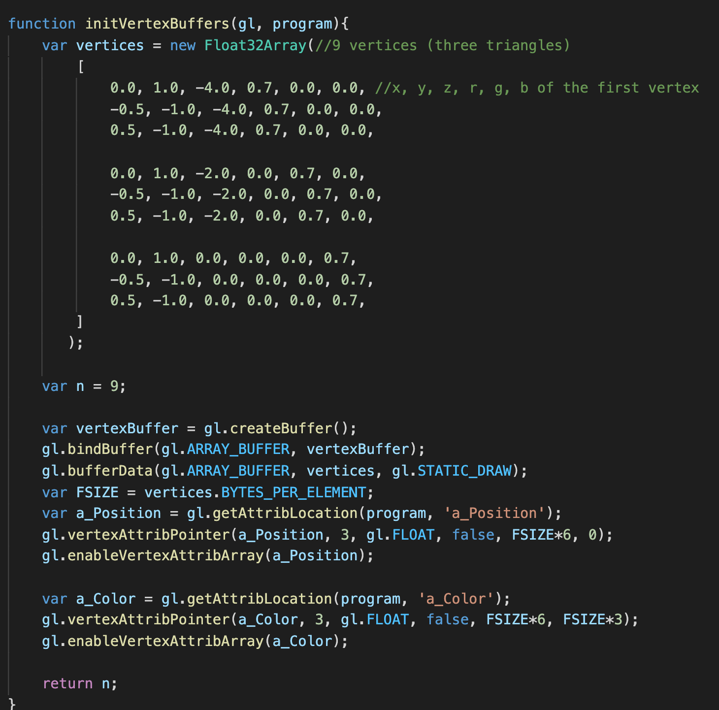
Example (Ex05-1)
Shaders
initVertexBuffers() in WebGL.js
The first triangle (red)
The second triangle (green)
The third triangle (blue)

Slide 8
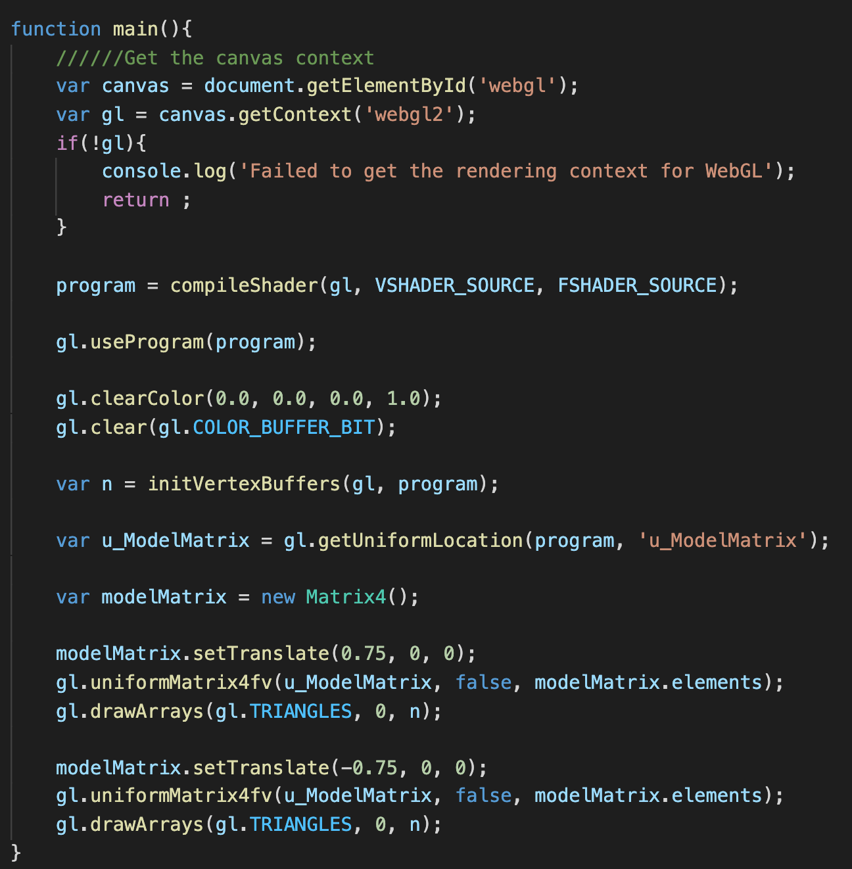
Example (Ex05-1)
main() in WebGL.js
translate the triangle set to draw
(do it twice with different translation
to draw two sets of triangles)

Slide 9
Let’s try and think (5mins)
Take a close look at triangle vertices array (x, y of each triangle are the same, but z is different)
Can you apply more transformations to the model matrix and let you can see the all triangles?
I already show you the long pipeline of 3D rendering, but we do not have the view matrix, projection matrix and viewport in the code. If so, what happens in the rendering pipeline?

Slide 10
View Matrix (World to View Space)
(Object space)
https://learnopengl.com/Getting-started/Coordinate-Systems
http://www.codinglabs.net/article_world_view_projection_matrix.aspx

Slide 11
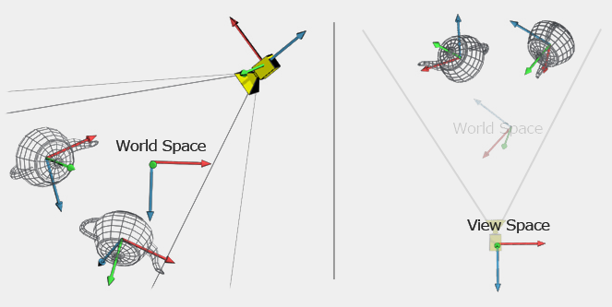
View Matrix (World to View Space)
This transformation is going to use the position of the camera as the origin to recalculate new coordinates of all vertices
All coordinates are determined by this point
which is origin of the world space
All coordinates are determined by this point
(where the camera is as the origin)

Slide 12
View Matrix (World to View Space)
Transform coordinates from the world space to the camera (eye) space
Make the following transformation (project and viewport) easily
How to define the view space?
Camera position
Camera looking direction
Camera up direction

Slide 13
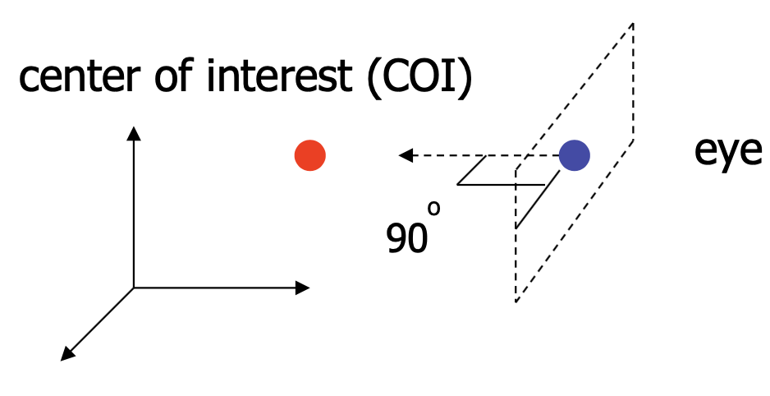
Build the View Space Coordinate System
Known: eye position, look-at point (COI), view-up vector
To find out: new origin and three basis vectors
Assumption: the direction of view is orthogonal
to the view plane (the plane objects will project into)

Slide 14
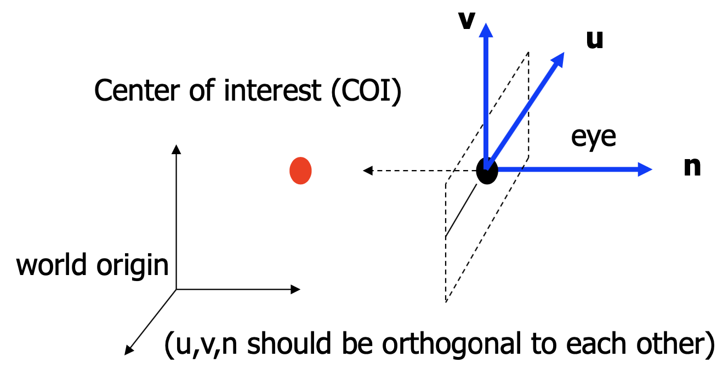
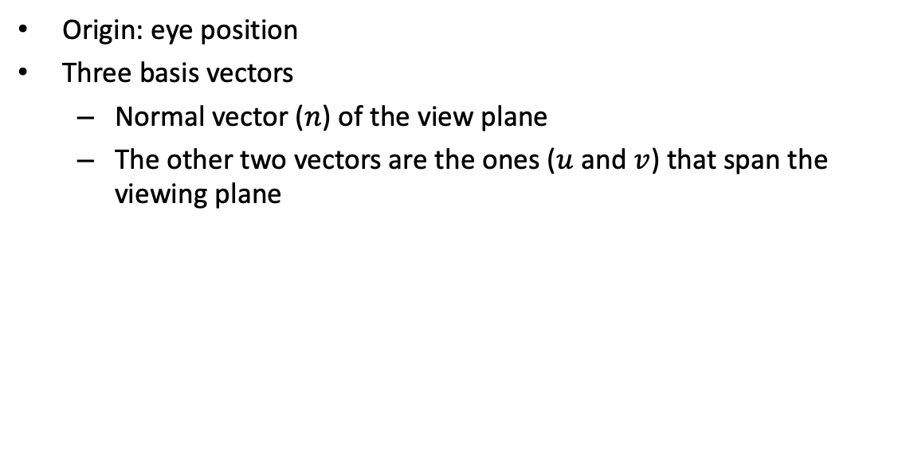
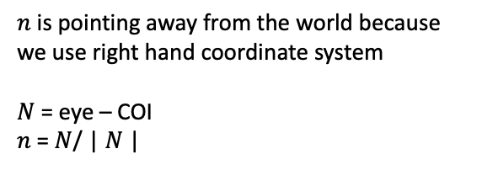
Build the View Space Coordinate System
Origin: eye position
Three basis vectors
Normal vector ($n$) of the view plane
The other two vectors are the ones ($u$ and $v$) that span the viewing plane
$n$ is pointing away from the world because we use right hand coordinate system
$N$ = eye – COI
$n$ = $N$/ | $N$|

Slide 15
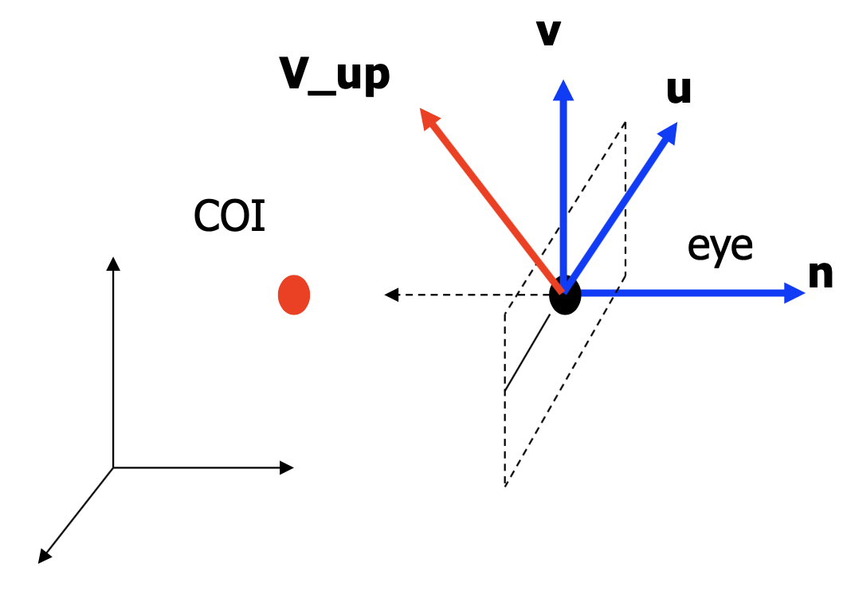
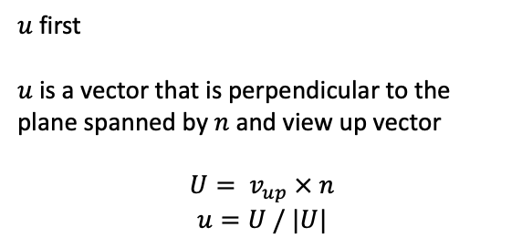

Build the View Space Coordinate System
How to get $u$ and $v$
$u$ first
$u$ is a vector that is perpendicular to the plane spanned by $n$ and view up vector
$$U= v_{up} × n$$
$$u=U / |U|$$

Slide 16
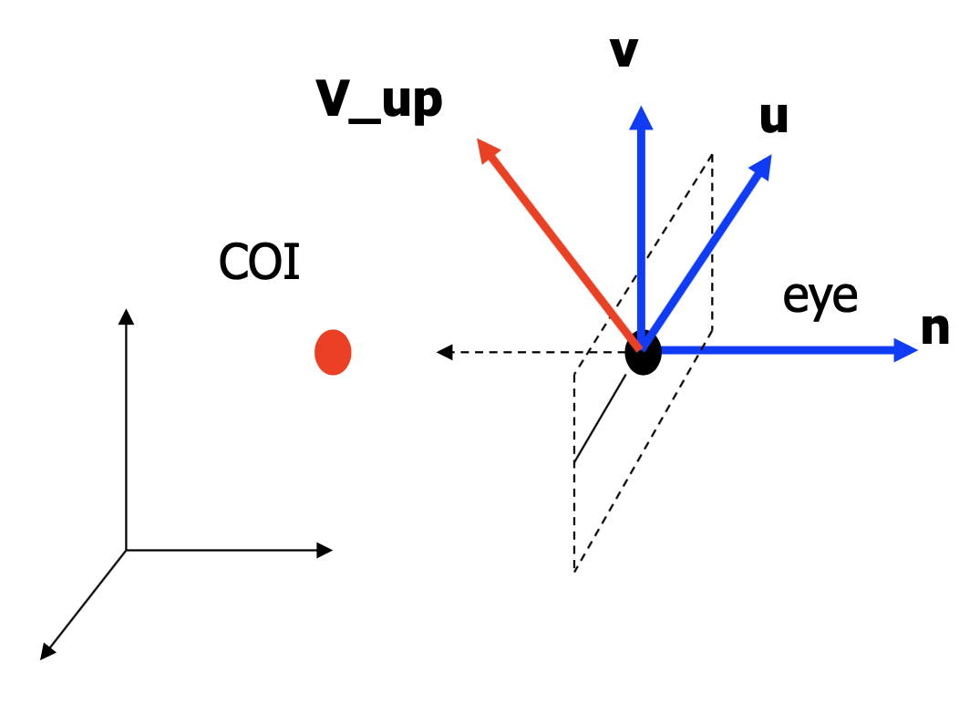


Build the View Space Coordinate System
How about $v$
$$v =n × u$$
$v$ is already normalized

Slide 17
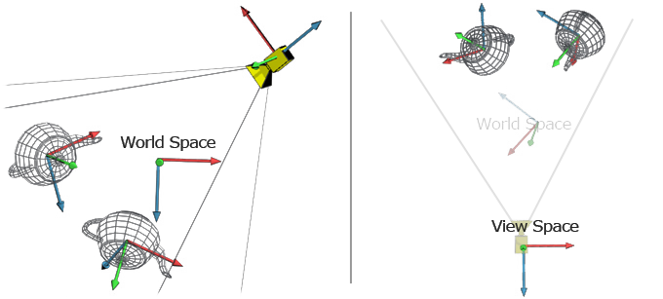
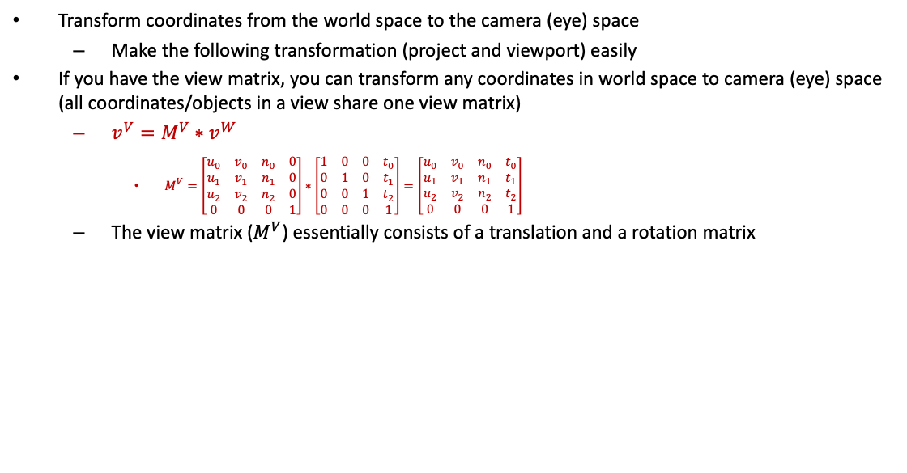
World to View Space in Mathematics
Transform coordinates from the world space to the camera (eye) space
Make the following transformation (project and viewport) easily
If you have the view matrix, you can transform any coordinates in world space to camera (eye) space (all coordinates/objects in a view share one view matrix)
$v^{V}=M^{V}∗v^{W}$
$M^{V}=\left[\begin{matrix}u_{0} & v_{0} & n_{0} & 0 \\ u_{1} & v_{1} & n_{1} & 0 \\ u_{2} & v_{2} & n_{2} & 0 \\ 0 & 0 & 0 & 1\end{matrix}\right]∗\left[\begin{matrix}1 & 0 & 0 & t_{0} \\ 0 & 1 & 0 & t_{1} \\ 0 & 0 & 1 & t_{2} \\ 0 & 0 & 0 & 1\end{matrix}\right]=\left[\begin{matrix}u_{0} & v_{0} & n_{0} & t_{0} \\ u_{1} & v_{1} & n_{1} & t_{1} \\ u_{2} & v_{2} & n_{2} & t_{2} \\ 0 & 0 & 0 & 1\end{matrix}\right]$
The view matrix ($M^{V}$) essentially consists of a translation and a rotation matrix
green: y+
red: x+
Blue: z+

Slide 18
Build View Matrix by cuon-matrix.js
How to create a view matrix?
”setLookAt()” in cuon-matrix.js
Matrix4.setLookAt(eyeX, eyeY, eyeZ, atX, atY, atZ, upX, upY, upZ)
eyeX, eyeY, eyeZ: camera position in world space
atX, atY, atZ: looking target in world space
upX, upY, upZ: up direction vector in world space

Slide 19

Coordinate System (Space)
$v$ is what the coordinate you put in the VBO and pass to shader
(that is the vertex defined in local/object space)
$$modelMatrix∗v$$
$$v = \left[\begin{matrix}x \\ y \\ z \\ 1\end{matrix}\right]$$
What “gl_Position” in shader wants
is the coordinate in clip space
(Object space)
$$viewMatrix∗modelMatrix∗v$$
https://learnopengl.com/Getting-started/Coordinate-Systems
http://www.codinglabs.net/article_world_view_projection_matrix.aspx

Slide 20
Example (Ex05-2)
Files:
Index.html
WebGL.js
Cuon-matrix.js

Slide 21
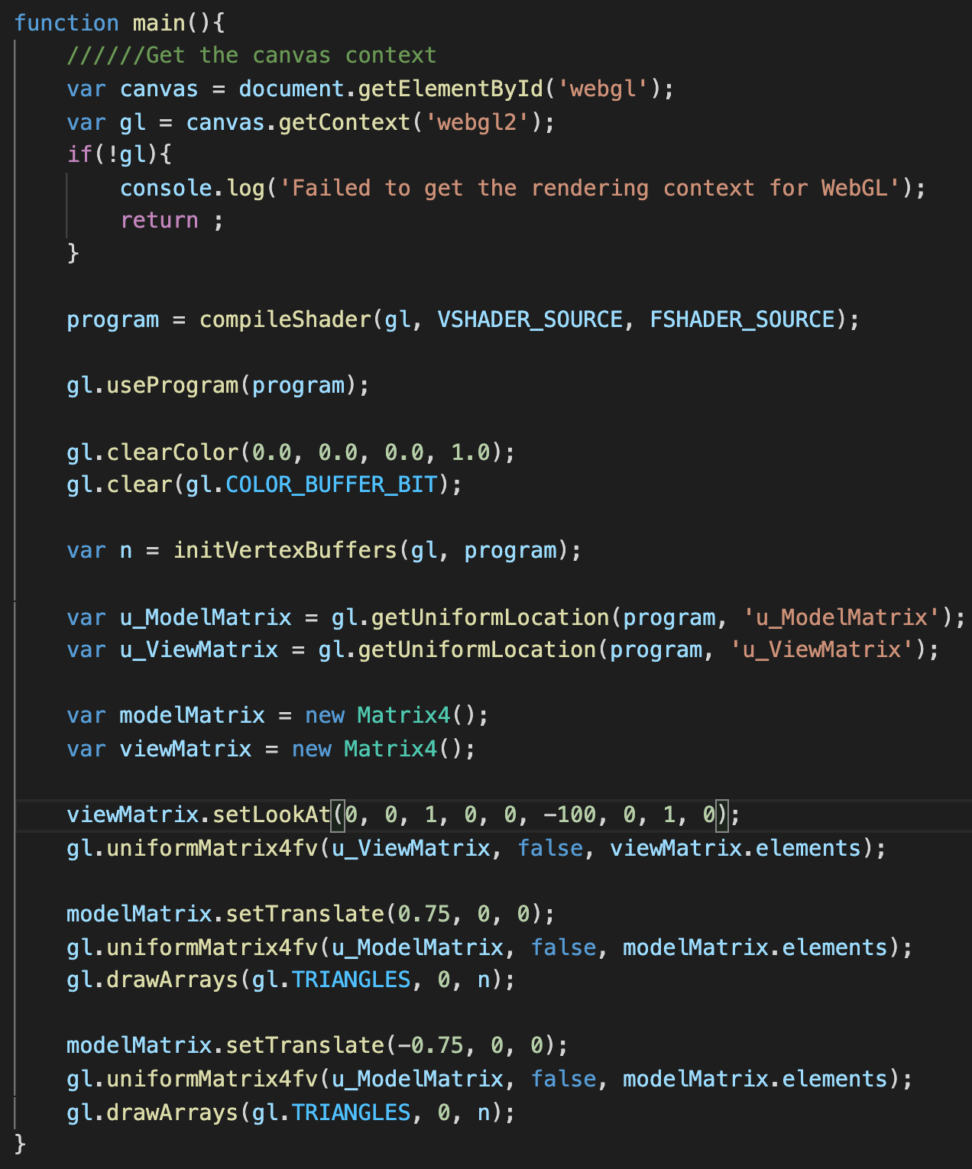
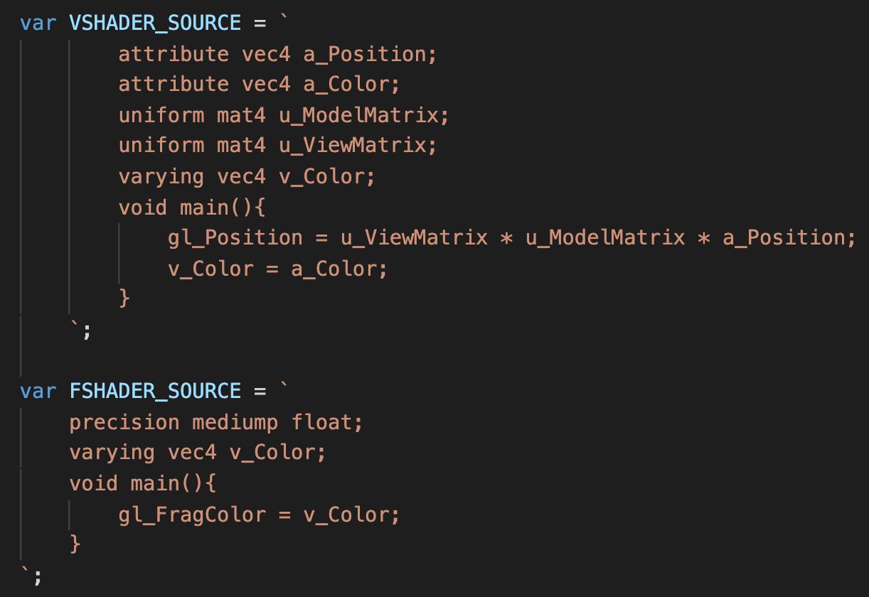
Example (Ex05-2)
Shader

Slide 22
Let’s try and think (5mins)
Try to modify the arguments in setLookAt() function to see the scene from other view angles (you will be able to see other triangles)
Make sure you know what is going on
What you see if you modify setLookAt() to
setLookAt(0, 0, 1, 0, 0, -100, 1, 0, 0);
setLookAt(-0.5, -0.5, -0.5, 0, 0, 0, 0, 1, 0);
setLookAt(-1, -1, -4.6, 0, 0, 0, 0, 1, 0);
You can try more!!
From the original Ex05-2 code
Modify setLookAt() to setLookAt(0, 0, 2, 0, 0, -100, 0, 1, 0)
Can you still see the triangles? (why)

Slide 23
Projection Matrix (View to Clip Space)
(Object space)
https://learnopengl.com/Getting-started/Coordinate-Systems
http://www.codinglabs.net/article_world_view_projection_matrix.aspx

Slide 24
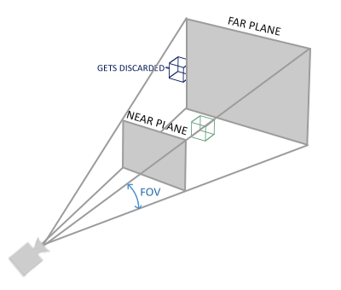
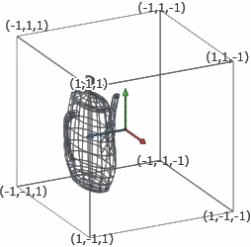
Projection Matrix (View to Clip Space)
Projection: map object/coordinates from 3D space to 2D screen
project everything in the visible volume into clip space
Clip space is described by normalized device coordinate (NDC) : a cube whose x, y, z axis ranges are between (-1,-1,-1) to (1,1,1)
Transform objects’ coordinates from view space to clip space
Why is it called clip space? After the projection matrix is defined, only the coordinates inside the region defined by the projection matrix will be included in the clip space
Perspective projection example

Slide 25
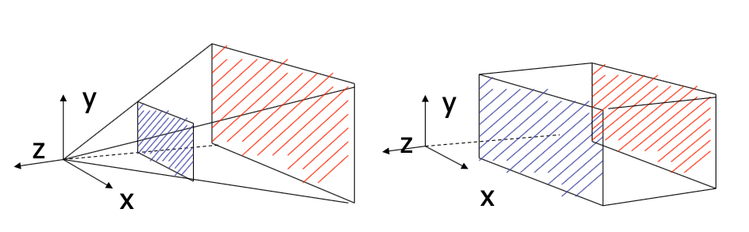
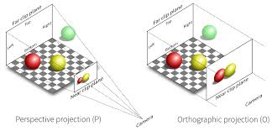
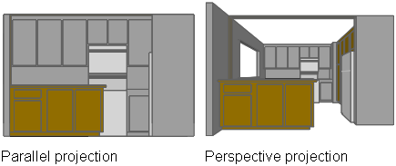
Projection Matrix (View to Clip Space)
Two types of projection:
perspective and orthographic projection
Perspective projection (real world projection)
Orthographic projection
(orthographic)

Slide 26
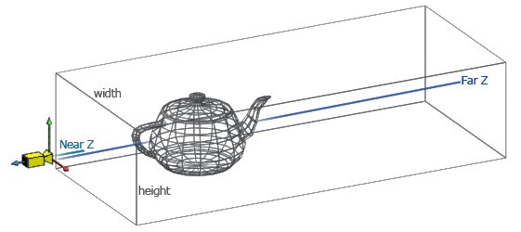
Orthographic Projection Matrix (View to Clip Space)
Orthographic project: all objects appear at the same scale
To do the orthographic projection, you should define the size of area that camera can see (width for x-axis, height for y-axis, z-near and z-far for z-axis)

Slide 27
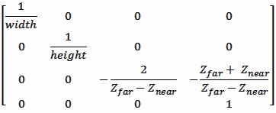

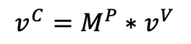
Orthographic Projection Matrix (View to Clip Space)
Vertices in clip space
$$v^{C}=M^{P}∗v^{V}$$
Orthographic projection matrix
(simple version: if xmin == -xmax and ymin==-ymax)
Vertices in view space
Projection matrix
Clip space
View space

Slide 28
Orthographic Projection Matrix (View to Clip Space)
How to create an orthographic projection matrix?
”setOrtho()” in cuon-matrix.js
Matrix4.setOrtho(xmin, xmax, ymin, ymax, znear, zfar)
xmin, xmax: boundaries along the x-axis of the clip space (define width)
ymin, ymax: boundaries along the y-axis of the clip space (define height)
znear, zfar: boundaries along the z-axis of the clip space

Slide 29
Coordinate System (Space)
$v$ is what the coordinate you put in the VBO and pass to shader
(that is the vertex defined in local/object space)
$$modelMatrix∗v$$
$$v = \left[\begin{matrix}x \\ y \\ z \\ 1\end{matrix}\right]$$
What “gl_Position” in shader wants
is the coordinate in clip space
(Object space)
$$viewMatrix∗modelMatrix∗v$$
$$gl_Position=projMatrix∗viewMatrix∗modelMatrix∗v$$
https://learnopengl.com/Getting-started/Coordinate-Systems
http://www.codinglabs.net/article_world_view_projection_matrix.aspx

Slide 30
Example (Ex05-3)
Files:
Index.html
WebGL.js
Cuon-matrix.js

Slide 31
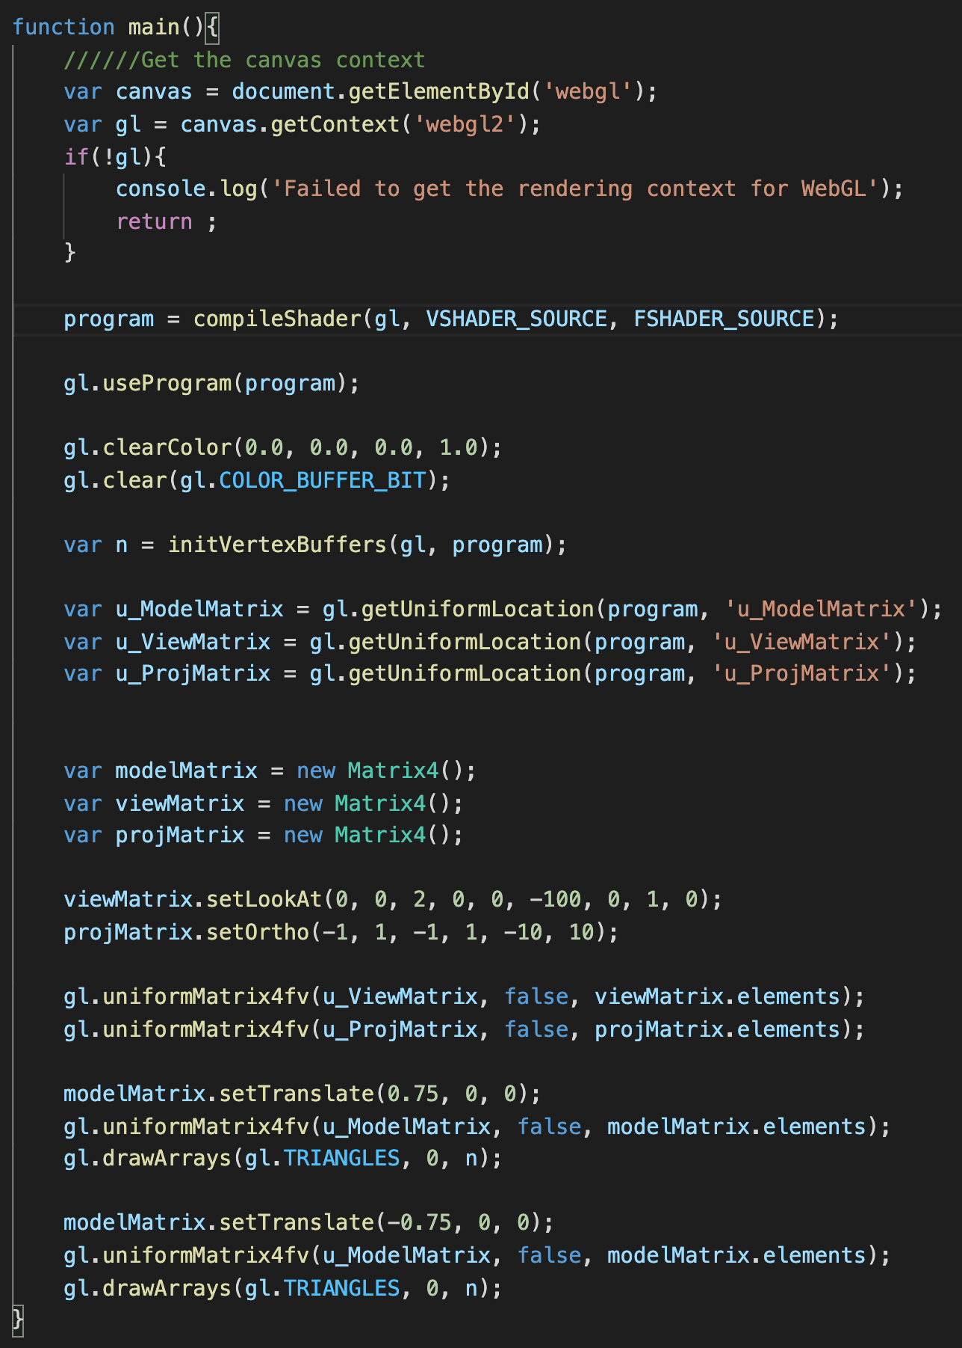
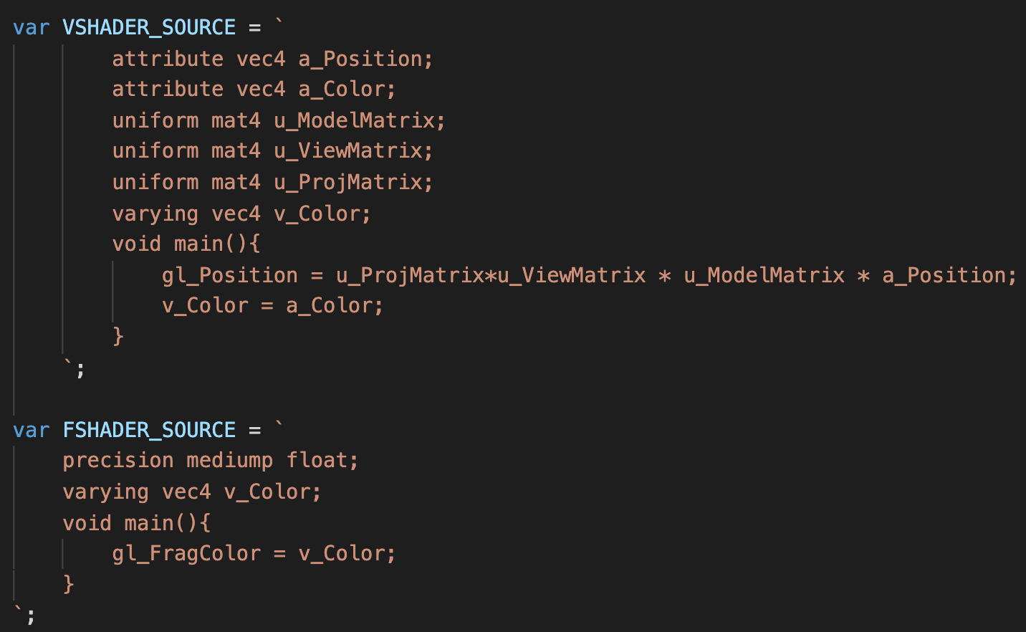
Example (Ex05-3)
main() in WebGL.js
Shader
We can see the blue triangles
even if we set the third argument of setLookAt() to 2

Slide 32
Let’s try and think (5mins)
What happen if you modify setOrtho() to
setOrtho(0, 1, -1, 1, -10, 10);
setOrtho(-10, 10, -10, 10, -10, 10);
setLookAt(5, 5, 5, 0, 0, 0, 0, 1, 0) and setOrtho(-5, 5, -5, 5, -20, 20);
Try any argument you want, make sure you understand why what you see happens

Slide 33
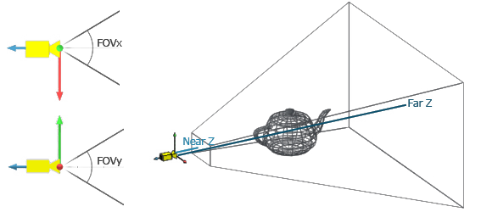
Perspective Projection Matrix (View to Clip Space)
Perspective: objects which are far away are smaller than those nearby
To do the perspective projection, you should define the fov of y axis (field of view), aspect ratio (width/height), z-near and z-far

Slide 34
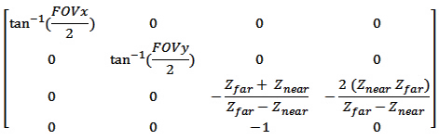
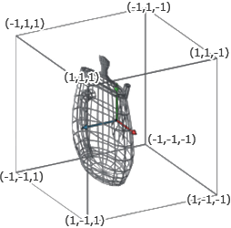
Perspective Projection Matrix (View to Clip Space)
Vertices in clip space
$$v^{C}=M^{P}∗v^{V}$$
fov-x can be derived by fov-y and aspect ratio
Vertices in view space
Perspective projection matrix
Projection matrix
Clip space
View space

Slide 35
Perspective Projection Matrix (View to Clip Space)
How to create an perspective projection matrix?
”setPerspective()” in cuon-matrix.js
Matrix4. setPerspective(fov, aspect, near, far)
fov: angle of field of view in degree along the y-axis
aspect: ratio of width and height (width/height) of the near clipping surface
znear, zfar: boundaries along the z-axis of the clip space

Slide 36
Coordinate System (Space)
$v$ is what the coordinate you put in the VBO and pass to shader
(that is the vertex defined in local/object space)
$$modelMatrix∗v$$
$$v = \left[\begin{matrix}x \\ y \\ z \\ 1\end{matrix}\right]$$
What “gl_Position” in shader wants
is the coordinate in clip space
(Object space)
$$viewMatrix∗modelMatrix∗v$$
$$gl_Position=projModel∗viewMatrix∗modelMatrix∗v$$
https://learnopengl.com/Getting-started/Coordinate-Systems
http://www.codinglabs.net/article_world_view_projection_matrix.aspx

Slide 37

Example (Ex05-4)
Files:
Index.html
WebGL.js
Cuon-matrix.js

Slide 38
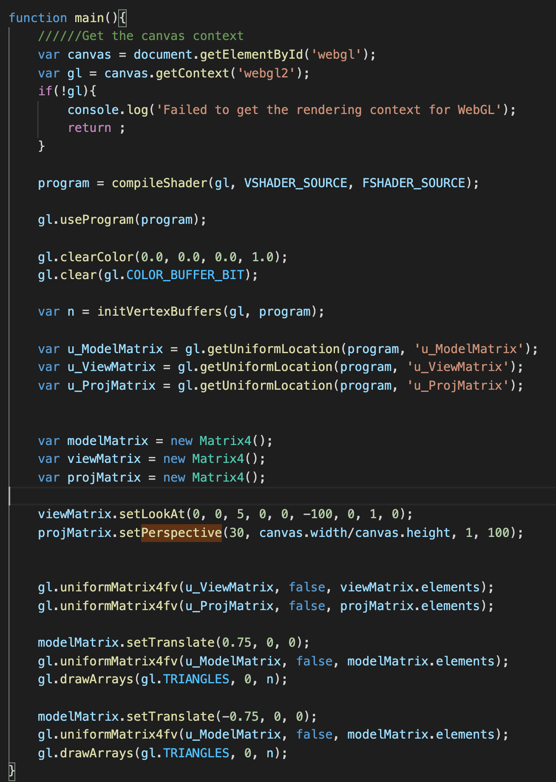
Example (Ex05-4)
main() in WebGL.js

Slide 39
Let’s try and think (5mins)
Now, the depth matters
Try to modify setLookAt() to setLookAt(0,0,2, 0,0,-100,0,1,0)
Go back to try Ex05-3
If you modify the third argument of setLookAt(), does what you see change?
change fov (the first argument) in setPerspective()?
change aspect (the second argument) in setPerspective() to 2 or 0.5?

Slide 40
Viewport Transformation (Clip to Screen Space)
(Object space)
https://learnopengl.com/Getting-started/Coordinate-Systems
http://www.codinglabs.net/article_world_view_projection_matrix.aspx

Slide 41
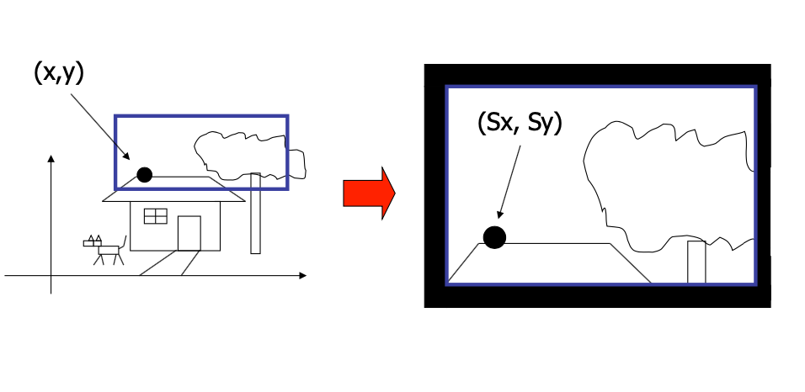
Viewport Transformation (Clip to Screen Space)
You can map clip space (x-y plane) to arbitrary sub-region of your canvas
How to calculate (sx, sy) from (x,y) (ignore z in clip space here)
Whole canvas (black region)
clip space
viewport
View space

Slide 42
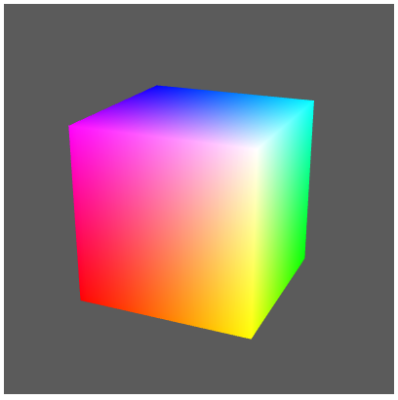
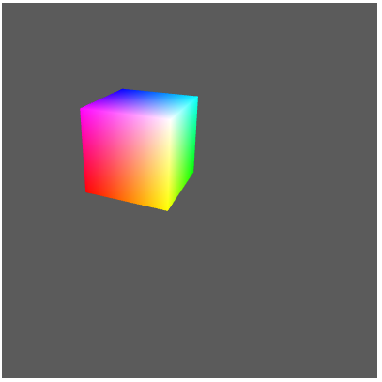
Viewport Transformation (Clip to Screen Space)
Just set different viewports
Viewport: whole canvas
Viewport: a portion of the canvas

Slide 43
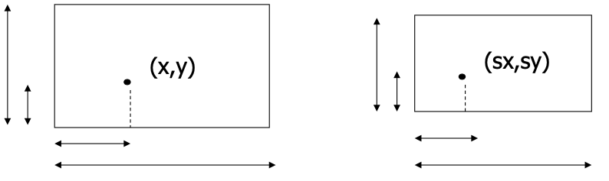
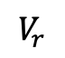
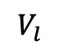
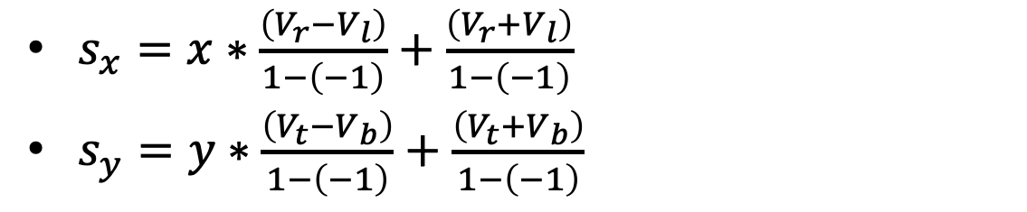
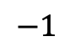
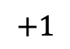
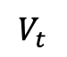
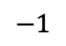
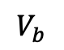
Viewport Transformation (Clip to Screen Space)
$$−1$$
$$+1$$
$$V_{r}$$
Clip space (x-y plane)
$$V_{l}$$
Viewport
+1
$$V_{t}$$
$$V_{b}$$
$$−1$$
$s_{x}=x∗\frac{\left(V_{r}−V_{l}\right)}{1−\left(−1\right)}+$ $\frac{\left(V_{r}+V_{l}\right)}{1−\left(−1\right)}$
$s_{y}=y∗\frac{\left(V_{t}−V_{b}\right)}{1−\left(−1\right)}+$ $\frac{\left(V_{t}+V_{b}\right)}{1−\left(−1\right)}$

Slide 44
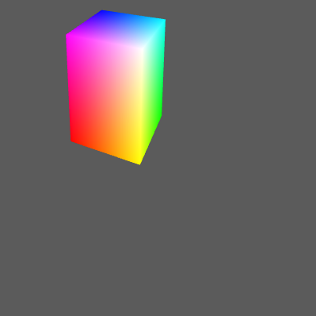
Viewport Transformation (Clip to Screen Space)
Question: when a distortion happens?
Clip space x-y plane in view space and viewport have different aspect ratio
What is “clip space x-y plane in view space ”?
Perspective projection example

Slide 45
Viewport Transformation (Clip to Screen Space)
So, if the ratio of the “near clip surface” and “viewport” are different, you will see a distortion.
Usually (not always), we set a 1:1 aspect ration for the near clip surface and use the whole canvas as the viewport
In this case, if the aspect ratio of you canvas is not 1:1, you will see a distortion
Perspective projection example

Slide 46
gl.viewport(x, y, width, height)
https://developer.mozilla.org/en-US/docs/Web/API/WebGLRenderingContext/viewport
Unit of x, y, width, height: pixels of the canvas
Left bottom corner is (0,0)
y
(0,0)
x

Slide 47

Example (Ex05-5)
Files:
Index.html
WebGL.js
Cuon-matrix.js

Slide 48
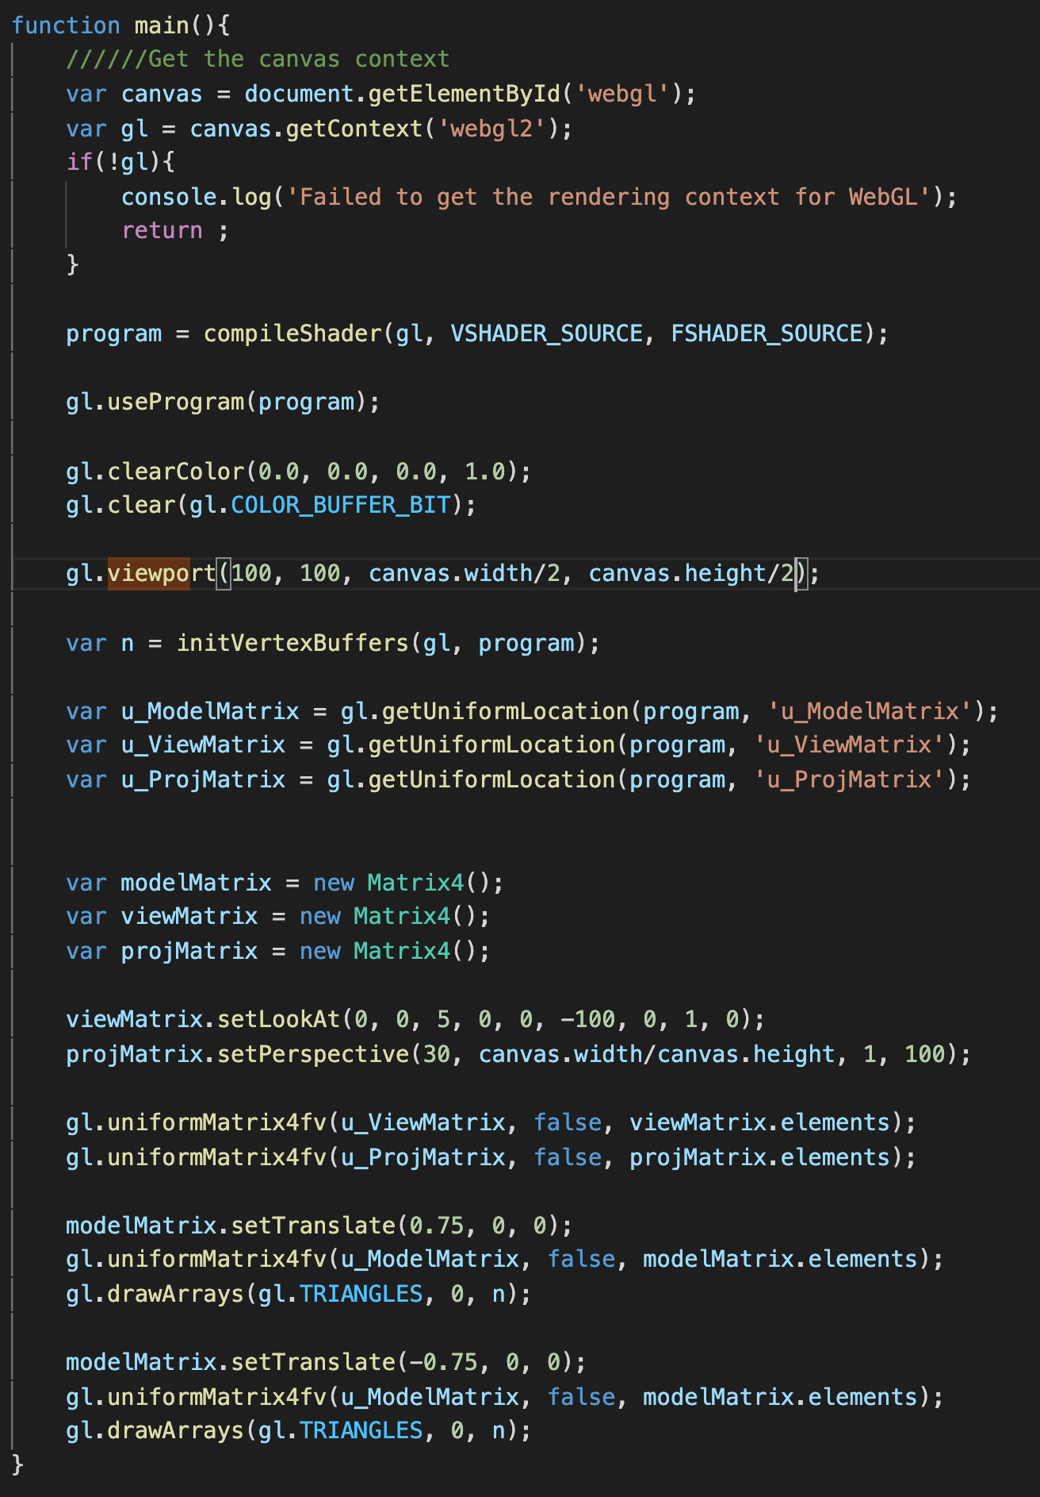
Example (Ex05-5)
main() in WebGL.js
You see smaller triangles just because we map the clip space to a smaller screen region

Slide 49
Let’s try and think (5mins)
Try to
Change the canvas height to 200 (in index.html)
and viewport() to gl.viewport(0, 0, canvas.width, canvas.height);
and setPerspective() to projMatrix.setPerspective(30, 1, 1, 100);
Then, run it
Does the result match your understanding?
From the original code of Ex05-5, change setLookAt() to setLookAt(0, 0, -6, 0, 0, 100, 0, 1, 0);
Looks like something wrong?

Slide 50


Recall the 2D Drawing
Do you remember this one when we just draw in 2D in the very beginning (I said the canvas x-y range from -1 to +1, I skip a lot of details). Now, we can review it again.
gl_position is defined in clip space and we use whole canvas as the viewport (default)
Ex1-3
var VSHADER_SOURCE = `
uniform vec4 u_Position;
void main(){
gl_Position = u_Position;
gl_PointSize = 10.0;
}
`;
var FSHADER_SOURCE = `
precision mediump float;
uniform vec4 u_FragColor;
void main(){
gl_FragColor = u_FragColor;
}
`;
(0.0, 1.0, 0.0, 1.0 )
Inside of screen
(-1.0, 0.0, 0.0, 1.0 )
Eye location
(0.0, 0.0, 0.0, 1.0 )
(1.0, 0.0, 0.0, 1.0 )
(0.0, -1.0, 0.0, 1.0 )

Slide 51


Visibility
A correct rendering requires correct visibility calculation
Another visibility example
Of course, we want the correct one
Wrong visibility
Correct visibility

Slide 52
Visibility
Where does WebGL deal with the visibility problem in the rendering pipeline?
Right after the viewport mapping, but before the display
(Object space)

Slide 53

Image Space Approach for Visibility
Determine which of the n objects is visible to each pixel on the image plane
for(each pixel in the image){
determine the object closest to the pixel
draw the pixel using the object’s color
}

Slide 54
Depth Buffer (Z-buffer)
Method used in most graphics hardware
Z-buffer algorithm
(There are still other approaches/algorithms to determine the visibility. Z-buffer algorithm is just one of them)
Basic idea
Rasterize every input polygon
For every pixel in the polygon interior, calculate corresponding Z value
Choose the color of the polygon whose z value closest to the eye to paint the pixel

Slide 55

Z-buffer Algorithm
Step 1: initialize the depth buffer with very large number

Slide 56


Z-buffer Algorithm
Step 2: WebGL may draw the blue polygon first (we must have depth (z) information of all object in clip space)

Slide 57

Z-buffer Algorithm
Step 2: Then, draw the yellow polygon

Slide 58
Depth Buffer in WebGL
It’s simple. Just call
gl.enable(gl.DEPTH_TEST)
And, before you draw any new frame, call
gl.clear(gl.DEPTH_BUFFER_BIT)
To clear the depth buffer for new frame

Slide 59

Example (Ex05-6)
Look into the scene from the other size with correct visibility
Files:
Index.html
WebGL.js
Cuon-matrix.js

Slide 60

Example (Ex05-6)
main() in WebGL.js
We change the setLookAt() to look into the scene from the other side
You have to call gl.enable(DEPTH_TEST) for once in your program
To ensure the correct visibility, you have to call gl.clear() to clear depth buffer before you draw a new frame

Slide 61
Example (Ex05-6)
gl.clear()
E.g. gl.clear(gl.DEPTH_BUFFER_BIT | gl.COLOR_BUFFER_BIT)
https://developer.mozilla.org/en-US/docs/Web/API/WebGLRenderingContext/clear
The input argument is a mask to indicate what buffers you want to clear
gl.DEPTH_BUFFER_BIT
gl.COLOR_BUFFER_BIT
gl.STENCIL_BUFFER_BIT
You can bitwise OR these bits to build a mask you want to clear multiple buffers

